Slide 1

Battle of Neighborhoods
Shebin Abdul latheef

Slide 2
Introduction
New York City's demographics show that it is a large and ethnically diverse metropolis. It is the largest city in the US and was home to nearly 8.5 million people in 2014. The New York region continues to be by far the leading metropolitan gateway for legal immigrants admitted into the United States.
New York City has also been a major point of entry for immigrants; the term "melting pot" was coined to describe densely populated immigrant neighbourhoods on the Lower East Side. As many as 800 languages are spoken in New York, making it the most diverse city in the world.
With its diverse culture, comes diverse food items. There are many restaurants in New York City, each belonging to different categories like Chinese, Indian, and French etc.

Slide 3
Problem
To find the answers to the following questions:
List and visualize all major parts of New York City that has great Indian restaurants.
What is best location in New York City for Indian Cuisine?
Which areas have potential Indian Restaurant Market?
Which all areas lack Indian Restaurants?
Which is the best place to stay if you prefer Indian Cuisine?

Slide 4

Data Section:
New York City data that contains list Boroughs, Neighbourhoods along with their latitude and longitude.
Data source : https://cocl.us/new_york_dataset
Description: This data set contains the required information to explore various neighbourhoods of New York City.
Indian restaurants in each neighbourhood of New York City.
Data source : Foursquare API
Description: Used to get all the venues in each neighbourhood. We can filter these venues to get only Indian restaurants.
GeoSpace data
Data source : https://data.cityofnewyork.us/City-Government/Borough-Boundaries/tqmj-j8zm
Description: By using this geo space data we will get the New York Borough boundaries that will help us visualize choropleth map.

Slide 5
Methodology:
We begin by collecting the New York city data from the available link
We will find all venues for each neighbourhood using Foursquare API.
We will then filter out all venues with Indian restaurant for further analysis.
Next using Foursquare API, we will find their Ratings, Tips, and Number of Likes.
We will then sort Neighbourhoods and Borough the data keeping Ratings as the constraint.
Next, we will consider all the neighbourhoods with average rating greater or equal 9.5 to visualize on map.
We will join this dataset to original New York data to get longitude and latitude.
Finally, we will visualize the Neighbourhoods based on average Rating using python’s Folium library.

Slide 6
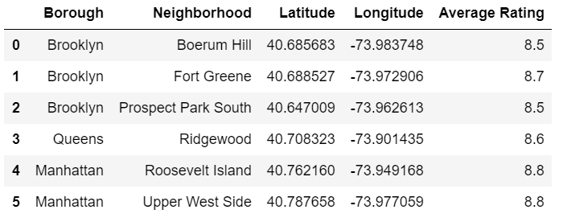
Conclusion:
So now we can answer the questions asked above in the Questions section:
The location given on the right in New York City has great Indian restaurants.
Upper West Side (Manhattan), Roosevelt Island (Manhattan), Fort Greene (Brooklyn) , Ridgewood (Queens) are some of the best neighbourhoods for Indian cuisine.
Brooklyn have potential Indian Restaurant Market.
Queens ranks last in average rating of Indian Restaurants, although just marginally.
Brooklyn is the best place to stay if you prefer Indian Cuisine.

Slide 7
Thank you..
Shebin Abdul latheef

